Slide 1
CHR MEBOOK
SH WCASE
2016-2017

Slide 2
What is elearning?
Classroom without walls

Slide 3
What is elearning?
No limitations

Slide 4
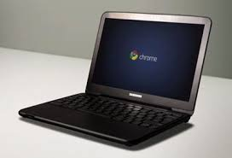
What is elearning?
1:1 Device for each student

Slide 5
Why elearning?
Promotes the 4 Cs: Collaboration, Critical Thinking, Communication, Creativity

Slide 6
Why elearning?
Prepares all students to be college and career ready.

Slide 7
General Information
Student use governed by the District’s Acceptable Use Policy for technology.

Slide 8
Technology User Fees
* Students who pay their technology use fee will be allowed to take the device home.
 | August 2016-May 2017
Student Fee | $30
Reduced Lunch Student Fee | $25
Free Lunch Student Fee | $20

Slide 9
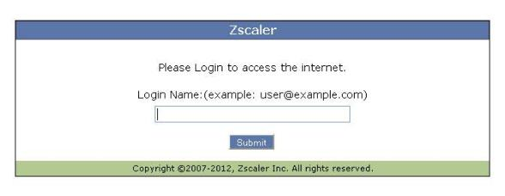
General Information
Internet access is monitored.
Contents of Chromebook are property of WCS and subject for review and monitoring.

Slide 10
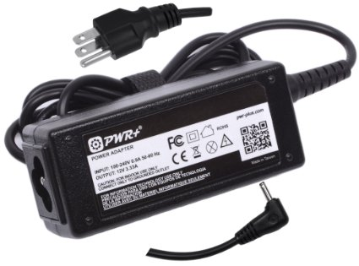
General Information
Charge the Chromebook with the charger provided. Charge overnight and leave charger at home to prevent loss or theft.

Slide 11
Chromebook Case
*All students are encouraged to get a case for their chromebook.
Model: HP Chromebook 11” G4
Vendors: Walmart, Amazon, Target,
and Best Buy.

Slide 12
Using the Chromebook
Keep work area and hands clean. Keep the Chromebook with you at all times and in a cool environment.

Slide 13
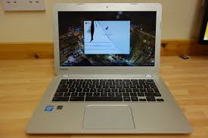
Using the Chromebook
Report any issues or damages to your Teacher, Technology Facilitator, or Media Coordinator.

Slide 14
Damage, Replacement, & Technical Issues
Students will be responsible for any damage due to negligence.

Slide 15
Repair and Pricing Process
In the event of physical damage or neglect to a device, damage charges will be assigned to the student in order to purchase repair parts.
Part | Price
Full Device | $180
Screen Replacement | $46.00
Charger | $60.00
TopCover/Keyboard | $69.00
Display Back Cover | $38.00
Bottom Base | $41.00
Screen Bezel | $29.00
* Damage due to negligence as well as loss or theft of a device will result in the student assuming the financial responsibility based on the current market value.

Slide 16
Student Handbook / AUP
Receive in homeroom on first day of school.
Sign and bring back to homeroom teacher.
Pay tech use fee.

